Slide 1
SMMD – Session 2: Confidence Intervals
Prof Vishnuprasad Nagadevara
Nagadevara_V@isb.edu

Slide 2
Learning Objectives
How to provide an interval estimate (confidence interval) for a population parameter such as mean and proportion?
How to adjust the interval estimate if the population standard deviation is not known?
What should be the sample size to collect for a desired width of the interval estimate?
Notes:
In the last class, we started looking at the concept of sampling inference, where we infer the parameters of the population using the statistics of the sample. We then spent quite a bit of time trying to understand different properties of the sample statistic, especially for the sample mean.
Now, we will return to the basic setting of interest, where we have no idea about the population mean but only have one sample in front of us. This is probably the most common situation after a survey or market research.
For the first time, we are going to move from point estimates to interval estimates. We will see that we can directly apply CLT if we can assume that the population standard deviation is known. Else, we will have to make some adjustments.
The standard deviation of the parameter of interest is sometimes a complex combination of the underlying confidence intervals of sample mean and proportion. We will see how to resolve that issue.
Then, we are going to flip the question and say, if I want my interval estimate to be of certain size, what sample size should I choose.

Slide 3


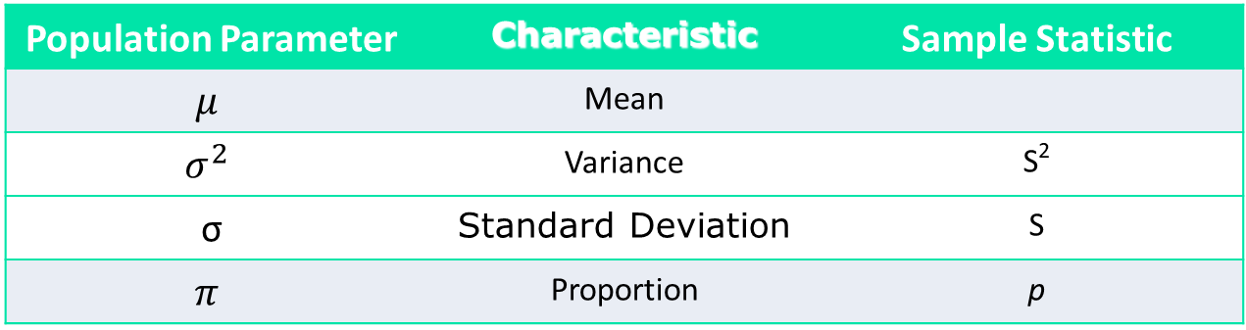

Sample statistics and population parameters
A sample statistic is a characteristic of the sample
Some sample statistics might be used as a point estimate for a population parameter
We use different notations to distinguish between the two groups of numbers
Population Parameter | Characteristic | Sample Statistic
$$μ$$ | Mean
$$σ^{2}$$ | Variance | S²
σ | Standard Deviation | S
$$π$$ | Proportion | p
$$\overline{X}$$
Notes:
OK, lets take an example. Population is the entire class of PGP. Say the parameter of interest to me is average work experience. Now tell me how to proceed.
“Someone will say select X random students from this class and take the average.” This is what we call as a sample mean and it is a sample statistic. Now if someone really pushed me, then I would give this as an estimate of the population mean. We call this as a point estimate.
What do you think of this point estimate?
It is reasonably good. Imagine that I slowly increase the size of my sample, what should happen to the sample mean. It should get closer and closer to the population parameter. If my sample is the entire population, they should match. Not every statistic has this property. Think about choosing the maximum of the sample and calling it a point estimate of the population. If I take larger and larger samples, it will never come close to the mean. In fact, it will only keep increasing.
But as we had said before there are problems with point estimates too. In order to understand these, I would like to explore some properties of the sample statistic and lets start with sample mean because it is easiest to understand.
But before that, let me spend a few minutes talking about samples.
3

Slide 4
Example: Campaign at SariSagar
SariSagar, an online retailer for designer saris. They are planning to introduce a new line of “tussar” silk saris, ranging between Rs. 2,180 and Rs. 8,420.
The success of the new line depends on the order size (in Rs.)
A sample of 2,000 potential customers were randomly selected from the database and a campaign is launched.
SariSagar received orders from 144 customers
Sample average (average order size) = ₹ 6,540
Based on the previous campaigns, it was assumed that the population standard deviation (σ) is ₹ 4,608 from previous such launches.
What can we say about the average order size that will be held after a full-fledged market launch?

Slide 5
Interval Estimates of Parameters
Based on the sample data:
The point estimate for mean order size = ₹ 6,540
Can we trust this estimate?
What do you think will happen if we took another random sample of 2000?
Because of this uncertainty, we prefer to provide the estimate as an interval (range) and associate a level of confidence with it
Interval Estimate: Point Estimate $±$ Margin of Error
Notes:
We have already seen that these 140 people are but one sample. If you were to do this again, would you get 1990? No, you might get something else. Of course, we don’t have the resources to keep doing this. We just have one sample.
So then, we are saying that the actual estimate is the point estimate plus minus some margin of error because of sampling variation.

Slide 6








Relationship between sample mean and population mean
Assume that sample size is large enough so that CLT can be applied.
The distribution of the sample means is $\overline{X}\sim N\left(μ,\frac{σ}{\sqrt{n}}\right)$
$$5\%$$
$$90\%$$
$$5\%$$
$$μ−1.645σ_{\overline{X}}$$
$$μ$$
$$μ+1.645σ_{\overline{X}}$$
$$\overline{X}$$
From normal distribution calculations, 90% of all possible sample means will lie within 1.645 SE of the population mean
Notes:
Move to the board → So now you want to say that mu = Xbar +/- something and you want to associate a probability to this range. Do you know of any concept that might be useful in establishing this relationship between Xbar and mu?
Well our friend, CLT. Take a look at this picture → draw the picture on board. This is just showing that the sample mean is distributed normally with mean mu and standard error sigma/sqrt(n). Now, say, I draw an interval of +/- 1.96 times the standard error around the mean. What is the probability corresponding to this area? Well, you are masters of the z-table now. So, it would be 95%. Write this in mathematical terms.
First, let’s interpret this. It means that a randomly picked sample has a probability of 95% to be in this range. Or in other words, 95% of the samples will be in this range.
But now, let’s not pretend. Let’s come to the situation in which we find ourselves. I don’t know mu and I have one value of Xbar. You are now in the opposite situation, where you have to say something about mu and you know xbar. For the moment assume that you know sigma.
Then, as you might have imagined, you can just flip the terms and what you get is that 95% chance that the population mean lies in the same range around the sample size. Let’s write this slightly differently. xbar – 1.96sigma/sqrt(n) to xbar + 1.96sigma/sqrt(n) is a confidence interval for mu. The probability that the mean will be in this range is 95%.

Slide 7
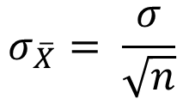
Probability Statement
$$P\left(μ−1.645σ_{\overline{X}}≤\overline{X}≤μ+1.645σ_{\overline{X}}\right)=0.90$$
$$P\left(−1.645σ_{\overline{X}}≤\overline{X}−μ≤+1.645σ_{\overline{X}}\right)=0.90$$
$$P\left(−\overline{X}−1.645σ_{\overline{X}}≤−μ≤−\overline{X}+1.645σ_{\overline{X}}\right)=0.90$$
$$P\left(\overline{X}+1.645σ_{\overline{X}}≥μ≥\overline{X}−1.645σ_{\overline{X}}\right)=0.90$$
$$P\left(\overline{X}−1.645σ_{\overline{X}}≤μ≤\overline{X}+1.645σ_{\overline{X}}\right)=0.90$$
$$σ_{\overline{X}}= \frac{σ}{\sqrt{n}}$$

Slide 8
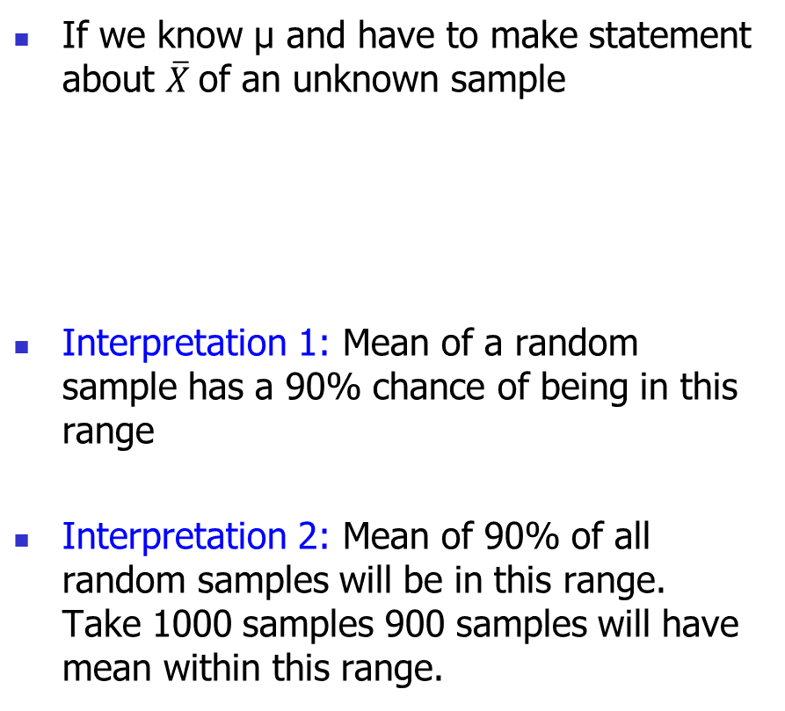
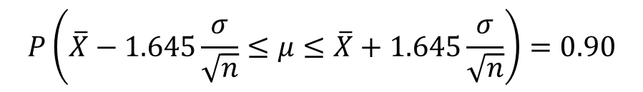
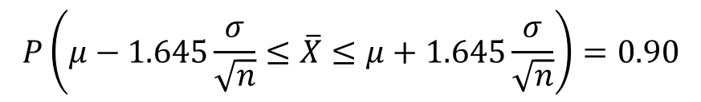
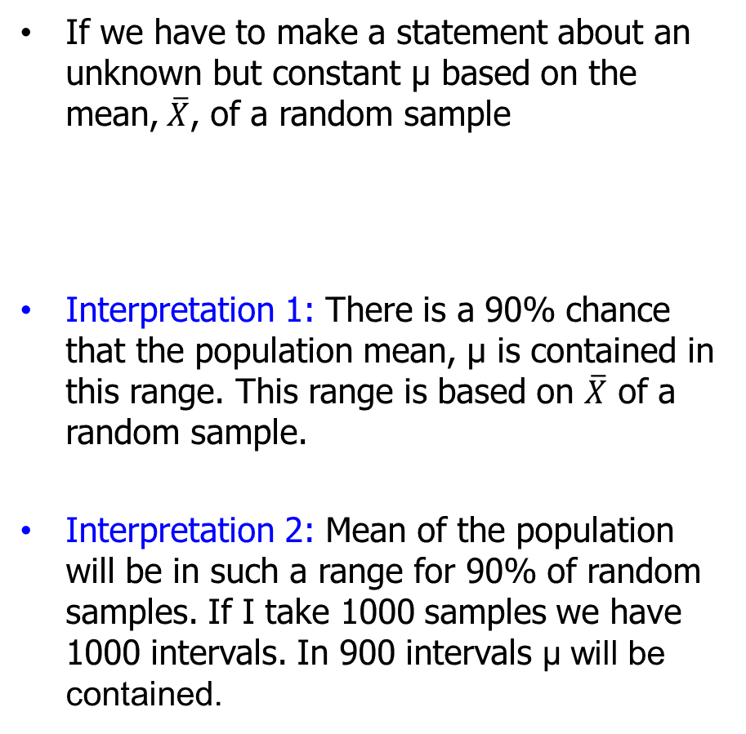
Flipping the relationship
If we have to make a statement about an unknown but constant μ based on the mean,$\overline{X}$, of a random sample
Interpretation 1: There is a 90% chance that the population mean, μ is contained in this range. This range is based on $\overline{X}$ of a random sample.
Interpretation 2: Mean of the population will be in such a range for 90% of random samples. If I take 1000 samples we have 1000 intervals. In 900 intervals μ will be contained.
If we know μ and have to make statement about $\overline{X}$of an unknown sample
Interpretation 1: Mean of a random sample has a 90% chance of being in this range
Interpretation 2: Mean of 90% of all random samples will be in this range. Take 1000 samples 900 samples will have mean within this range.
$$P\left(\overline{X}−1.645\frac{σ}{\sqrt{n}}≤μ≤\overline{X}+1.645\frac{σ}{\sqrt{n}}\right)=0.90$$
$$P\left(μ−1.645\frac{σ}{\sqrt{n}}≤\overline{X}≤μ+1.645\frac{σ}{\sqrt{n}}\right)=0.90$$
Notes:
This discussion is summarized on this slide too.
Move to board → Let’s generalize this discussion. Let’s start with what you have: (i) xbar, (ii) sigma (we will come to this in a few minutes), and (iii) level of confidence, which is a managerial choice. Let’s call is (1-alpha). So if confidence level is 95%, alpha is 0.005. Then, you are going to look up a value of z that corresponds to alpha/2 and use it to construct intervals and include your margin of error.
Show the next slide.

Slide 9














Interpretation
What is the random variable?
$$90\%$$
$$5\%$$
$$5\%$$
$$2∗1.645σ_{\overline{X}}$$
$${\overline{X}}_{2}$$
$${\overline{X}}_{4}$$
$${\overline{X}}_{1}$$
$${\overline{X}}_{3}$$
$$μ$$
$$\overline{X}$$
$$2∗1.645σ_{\overline{X}}$$
$$2∗1.645σ_{\overline{X}}$$
$$2∗1.645σ_{\overline{X}}$$
$$2∗1.645σ_{\overline{X}}$$
Notes:
Move to the board → So now you want to say that mu = Xbar +/- something and you want to associate a probability to this range. Do you know of any concept that might be useful in establishing this relationship between Xbar and mu?
Well our friend, CLT. Take a look at this picture → draw the picture on board. This is just showing that the sample mean is distributed normally with mean mu and standard error sigma/sqrt(n). Now, say, I draw an interval of +/- 1.96 times the standard error around the mean. What is the probability corresponding to this area? Well, you are masters of the z-table now. So, it would be 95%. Write this in mathematical terms.
First, let’s interpret this. It means that a randomly picked sample has a probability of 95% to be in this range. Or in other words, 95% of the samples will be in this range.
But now, let’s not pretend. Let’s come to the situation in which we find ourselves. I don’t know mu and I have one value of Xbar. You are now in the opposite situation, where you have to say something about mu and you know xbar. For the moment assume that you know sigma.
Then, as you might have imagined, you can just flip the terms and what you get is that 95% chance that the population mean lies in the same range around the sample size. Let’s write this slightly differently. xbar – 1.96sigma/sqrt(n) to xbar + 1.96sigma/sqrt(n) is a confidence interval for mu. The probability that the mean will be in this range is 95%.

Slide 10
Confidence Interval for the Population Mean
Start by choosing a confidence level (1-α) (e.g. 95%, 99%, 90%)
α is the “error” we are ‘willing’ to tolerate
Then, the population mean will be within
Margin of error depends on the underlying uncertainty (σ), confidence level (Z_{1- α}) and the sample size (n)
, where z_{1-α} satisfies P(-z_{1-α} ≤ Z ≤ z_{1-α}) = 1-α
Interval estimate
=
Point estimate
±
Margin of error
Notes:
Note that the size of the interval depends on the underlying uncertainty (sigma), confidence level (sigma) and sample size (n). This is very intuitive. If your sample size is larger, you have more information and hence you can be equally confident with a shorter interval. Of course, if the underlying uncertainty is very high, you cannot do much; that will add to the confidence interval.
Any question on this?
10

Slide 11
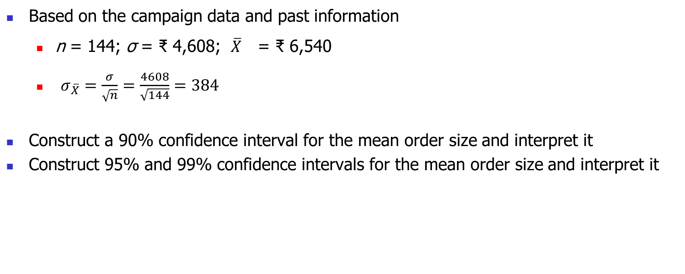
SariSagar
Based on the campaign data and past information
n = 144; σ = ₹ 4,608; $\overline{X}$ = ₹ 6,540
$σ_{\overline{X}}=\frac{σ}{\sqrt{n}}=\frac{4608}{\sqrt{144}}=384$
Construct a 90% confidence interval for the mean order size and interpret it
Construct 95% and 99% confidence intervals for the mean order size and interpret it
Launch Poll 1
Trade-off between level of confidence and accuracy
Notes:
Let’s do these calculations for a couple of examples of the credit card.
First, for 95%, alpha = 0.05. z-value is 1.96. The range is 1990 +/- 211.29*1.96. Then the upper limit is 2404 and the lower limit is 1575.
Can you repeat this exact thing for 90% confidence? z-value is 1.6445. The interval is 1642 to 2337.
Again, we can see that if you want narrower range, you will have to compromise on the confidence.
11

Slide 12
(Mis)Interpreting the Confidence Interval
Consider the 90% Confidence Interval for the mean order size: [₹ 5908, ₹ 7172]
Does this mean that
The mean order size of the population lies in this range?
The mean order size is in this range 90% of the time?
90% of the potential customers place this order size?
Notes:
Agenda for Session 4:
Recap of central limit theorem and Confidence Interval – 25 min
T values – 25 min
Break – 10 min
Confidence Interval for Proportions – 40 min
Sample sizing – 30 min
Let’s spend sometime on the managerial interpretation of the confidence interval. Which of these is a right?
OK, remember that the correct interpretation is that if I get many samples, then 95% of the times the population mean is going to lie in the respective intervals.

Slide 13
What if we don’t know σ?

Slide 14
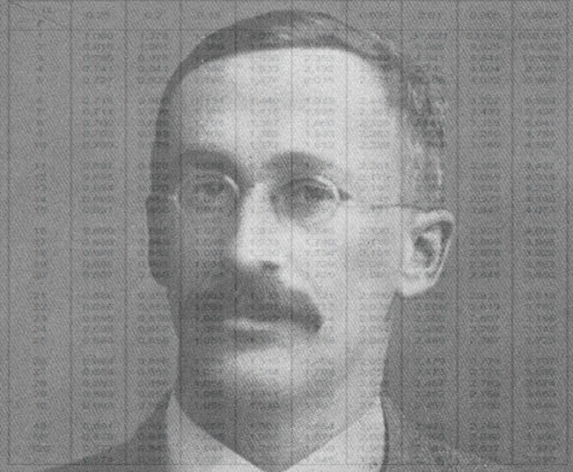
t-Distribution
William Gossett of Guinness Breweries
Published “The Probable Error of the Mean”
Why “Student”?
Ronald Fisher Extended the Concept

Slide 15
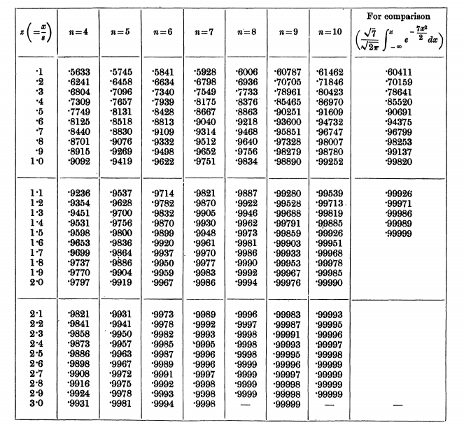
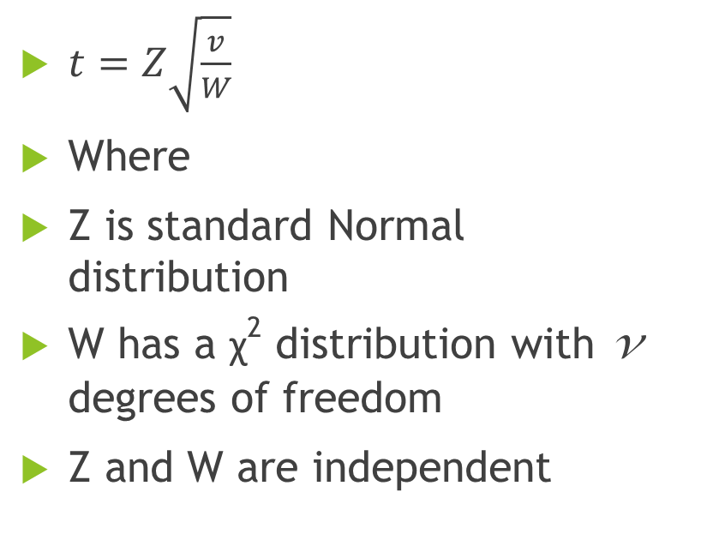
The original “t” Table
$t=Z\sqrt{\frac{v}{W}}$
Where
Z is standard Normal distribution
W has a χ² distribution with v degrees of freedom
Z and W are independent

Slide 16
Degrees of Freedom
Given the sampling frame below, how many of the empty cells can be filled with any value? (without violating the row and column totals)
Gender | Hyderabad | Bangalore | Delhi | Total
Male | 20 | 40 | 20 | 80
Female | 30 | 30 | 60 | 120
Total | 50 | 70 | 80 | 200

Slide 17
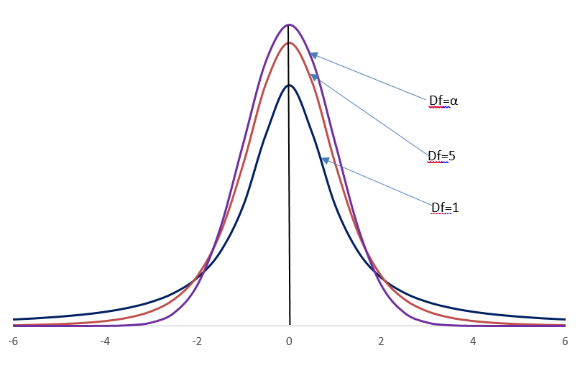

t – Distribution
Standard Normal
$$t=\frac{\left(\overline{X}−μ\right)}{S_{\overline{X}}}$$
t vs. Normal distribution

Slide 18
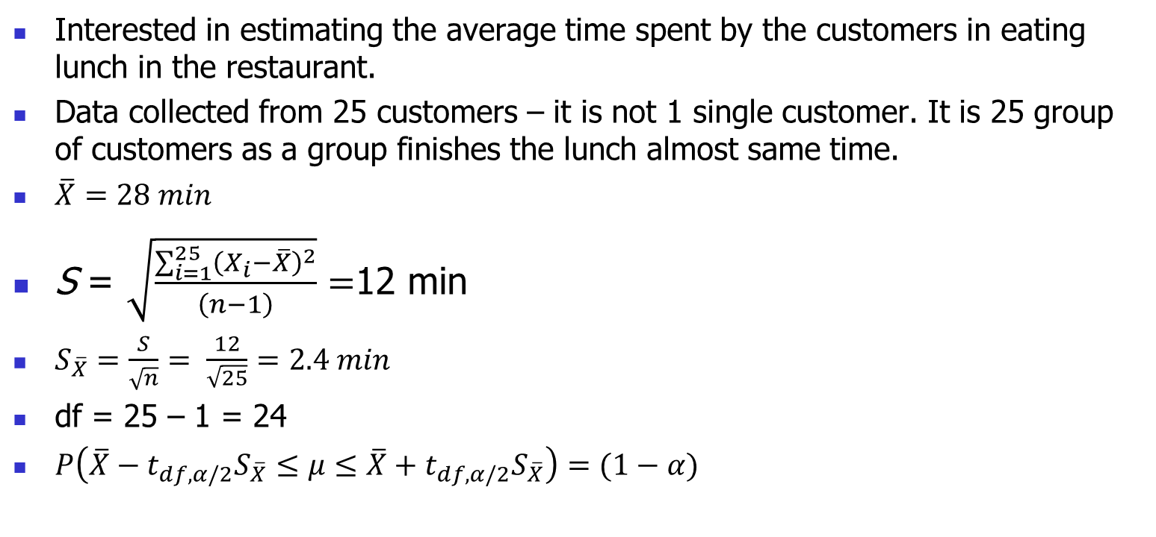
Example
Interested in estimating the average time spent by the customers in eating lunch in the restaurant.
Data collected from 25 customers – it is not 1 single customer. It is 25 group of customers as a group finishes the lunch almost same time.
$\overline{X}=28 min$
S = $\sqrt{\frac{\sum_{i=1}^{25}{{\left(X_{i}−\overline{X}\right)}^{2}}}{\left(n−1\right)}}=$12 min
$S_{\overline{X}}=\frac{S}{\sqrt{n}}= \frac{12}{\sqrt{25}}=2.4 min$
df = 25 – 1 = 24
$P\left(\overline{X}−t_{df, α/2}S_{\overline{X}}≤μ≤\overline{X}+t_{df, α/2}S_{\overline{X}}\right)=(1−α)$

Slide 19
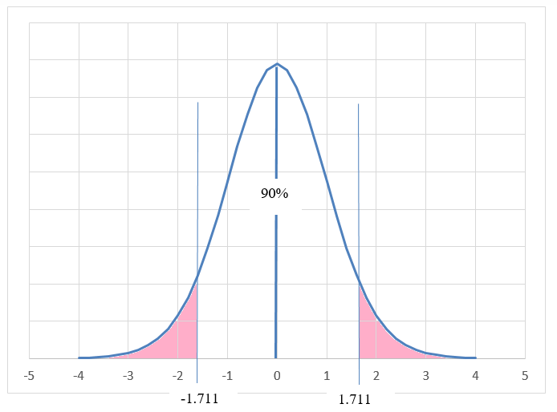

t – Distribution with 24 degrees of freedom
$$t_{24,(0.05)}=1.711$$

Slide 20
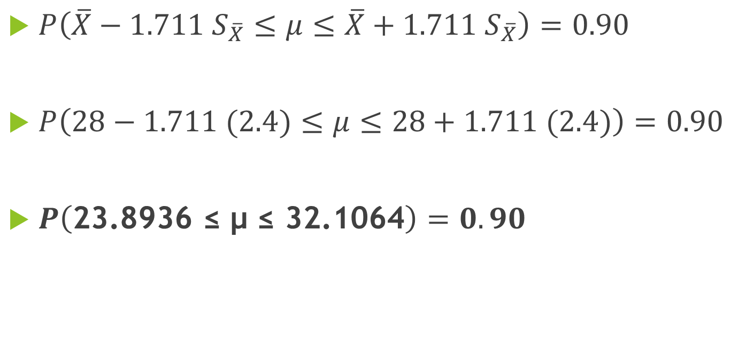
90 percent Confidence Interval
$P\left(\overline{X}−1.711 S_{\overline{X}}≤μ≤\overline{X}+1.711 S_{\overline{X}}\right)=0.90$
$P\left(28−1.711 (2.4)≤μ≤28+1.711 (2.4)\right)=0.90$
$P\left(\text{23.8936 ≤ µ ≤ 32.1064}\right)=0.90$

Slide 21
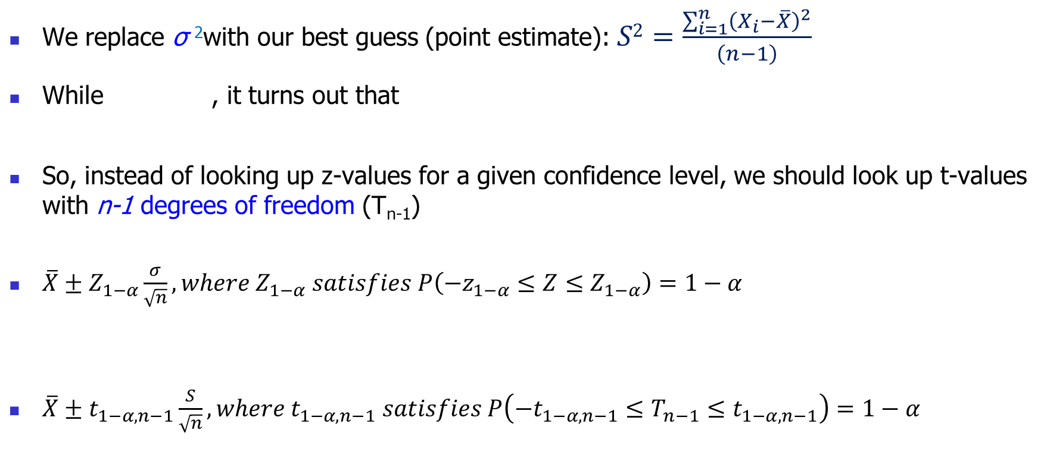
Summary
We replace σ ²with our best guess (point estimate): $S2=\frac{\sum_{i=1}^{n}{{\left(X_{i}−\overline{X}\right)}^{2}}}{\left(n−1\right)}$
While , it turns out that
So, instead of looking up z-values for a given confidence level, we should look up t-values with n-1 degrees of freedom (T_{n-1})
$\overline{X}±Z_{1−α}\frac{σ}{\sqrt{n}}, where Z_{1−α} satisfies P\left(−z_{1−α}≤Z≤Z_{1−α}\right)=1−α$
$\overline{X}±t_{1−α,n−1}\frac{S}{\sqrt{n}}, where t_{1−α,n−1} satisfies P\left(−t_{1−α,n−1}≤T_{n−1}≤t_{1−α,n−1}\right)=1−α$
Notes:
One big problem is that this statistic is distributed according to t-distribution only when the population is normally distributed. This is more restrictive than the central limit theorem. But we can relax; people have done research and shown that deviations from normality don’t matter much.
The other thing to remember is that t-distribution has a s in it and s has a n-1 in it. So every t-distribution will have an associated n-1, which we will call as degrees of freedom.
21

Slide 22

Calculating t-values
Notes:
Let’s see how to look that up. If you look at the table, you will see something called tail probability. For our confidence of 95%, that is equal to 2.5% or 0.0025. Now keep going down the column until you can find degree of freedom equal to 140. To be safe because we cannot see the value for 140, we will use for 100.

Slide 23
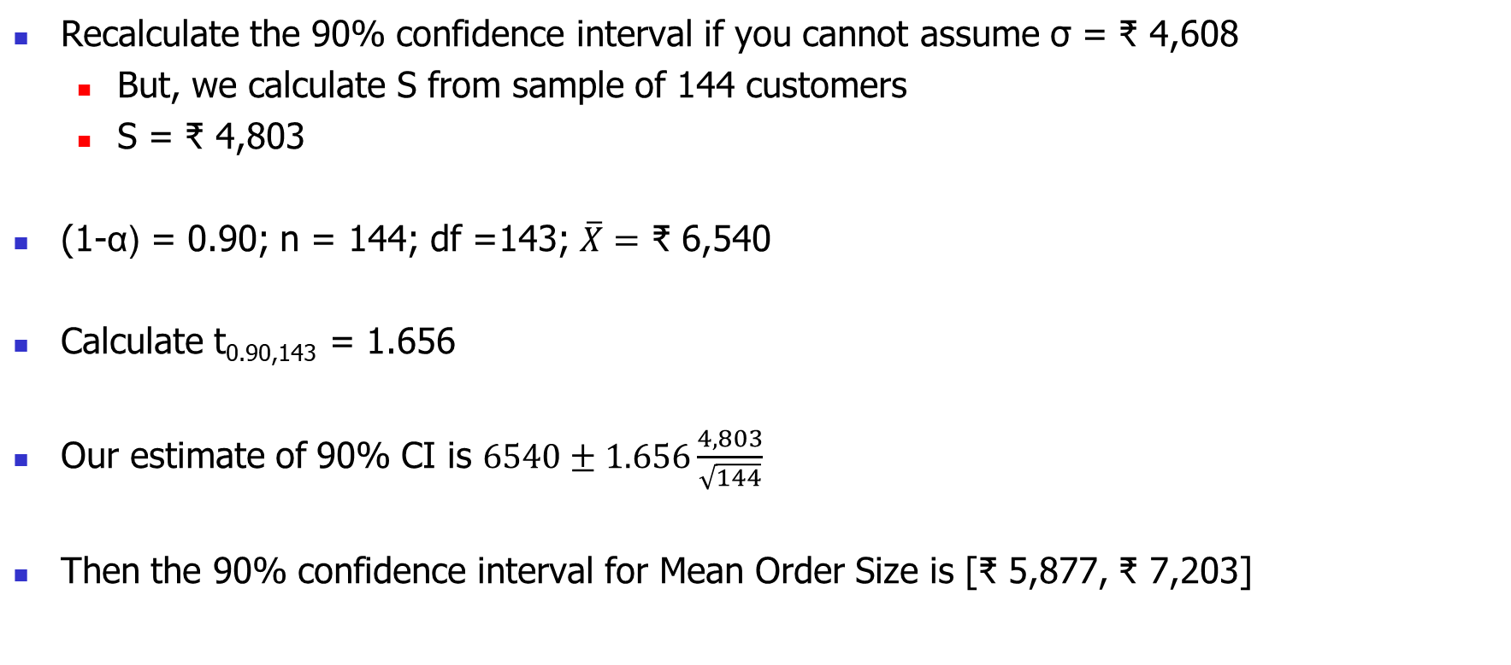
Back to SariSagar
Recalculate the 90% confidence interval if you cannot assume σ = ₹ 4,608
But, we calculate S from sample of 144 customers
S = ₹ 4,803
(1-α) = 0.90; n = 144; df =143; $\overline{X}=$ ₹ 6,540
Calculate t_{0.90,143} = 1.656
Our estimate of 90% CI is $6540±1.656\frac{4,803}{\sqrt{144}}$
Then the 90% confidence interval for Mean Order Size is [₹ 5,877, ₹ 7,203]
Notes:
Do we see what happened? Well, our confidence interval widened because we had less information for the same confidence level.

Slide 24
SariSagar - Proportion of Orders
Until now, we worked with the sample of potential customers who accepted the offer
However, this represents only successful orders from 144 of 2,000 to whom an offer was sent
What if we wanted to estimate the proportion of the entire population that will accept the offer?
Notes:
Does this question make sense? It is not enough to focus on the profit that you make of those who get it. Because you are spending a lot of money on those who will not join.
Move to board → Well, the good thing is that the proportions can also be interpreted as an average but of another random variable.
Consider a random variable Ai that denotes whether a card is accepted or not. It is 1 with probability pi and 0 with probability 1-pi. Then, we want to estimate pi, which is the population average of Ai and what we have is a sample mean of that random variable.
So, we can then apply all that we have learnt from the central limit theorem. Except that the standard error needs to be calculated carefully.

Slide 25
Confidence Interval for π (Population Proportion)

Slide 26
Distribution of Sample Proportion
Claim: Population Proportion (π) is mean of an “appropriately” constructed random variable
Then, sample proportion (p) is the sample mean of that random variable
Using CLT, we can establish that sample proportion,
The required sample size for CLT to apply np >10 and n(1-p) > 10

Slide 27
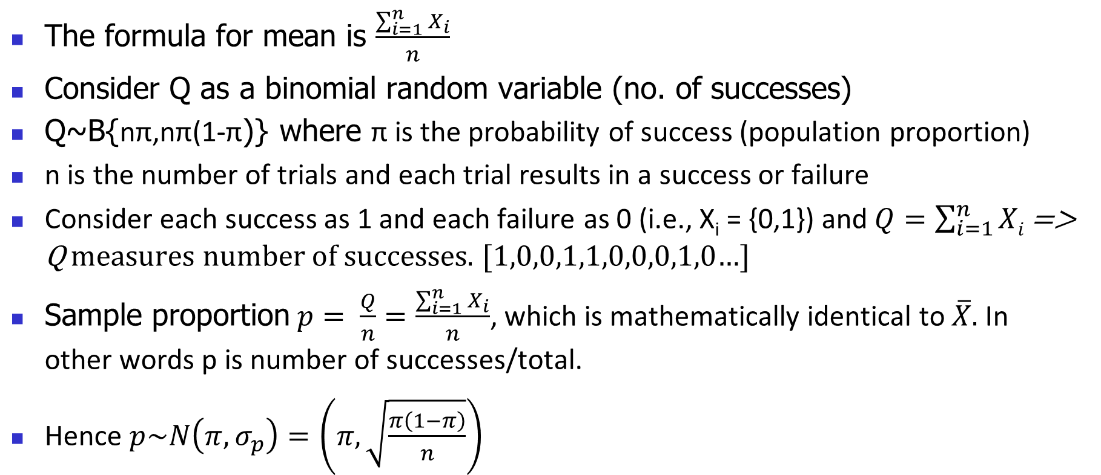
Distribution of sample proportion, p
The formula for mean is $\frac{\sum_{i=1}^{n}{X_{i}}}{n}$
Consider Q as a binomial random variable (no. of successes)
Q~B{nπ,nπ(1-π)} where π is the probability of success (population proportion)
n is the number of trials and each trial results in a success or failure
Consider each success as 1 and each failure as 0 (i.e., X_{i} = {0,1}) and $Q=\sum_{i=1}^{n}{Xi}$ => Q measures number of successes. [1,0,0,1,1,0,0,0,1,0…]
Sample proportion$p= \frac{Q}{n}=\frac{\sum_{i=1}^{n}{X_{i}}}{n}$, which is mathematically identical to $\overline{X}.$ In other words p is number of successes/total.
Hence $p\sim N\left(π,σ_{p}\right)=\left(π,\sqrt{\frac{π\left(1−π\right)}{n}}\right)$

Slide 28
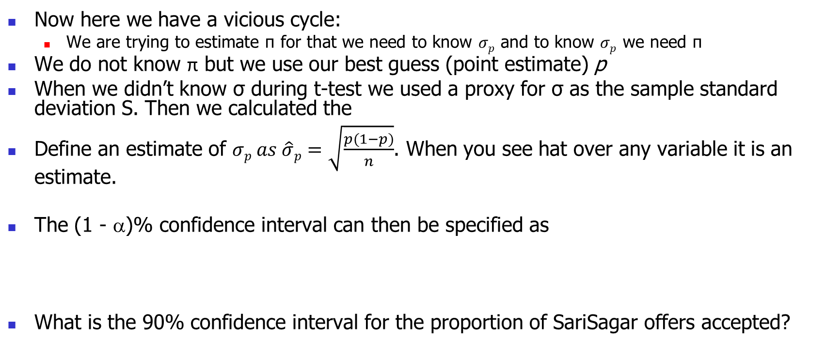
Confidence Interval for Proportion
Now here we have a vicious cycle:
We are trying to estimate π for that we need to know $σp$ and to know $σp$ we need π
We do not know π but we use our best guess (point estimate) p
When we didn’t know σ during t-test we used a proxy for σ as the sample standard deviation S. Then we calculated the
Define an estimate of $σp as \hat{σ}p=\sqrt{\frac{p(1−p)}{n}}$. When you see hat over any variable it is an estimate.
The (1 - α)% confidence interval can then be specified as
What is the 90% confidence interval for the proportion of SariSagar offers accepted?
Notes:
In order to estimate the margin of error, we use the standard error and the z-value and not the t-value. The simple answer is that we are not replacing the standard deviation of the population with the standard deviation of the sample. We are still substituting the mean of the population with the mean of the sample.
28

Slide 29
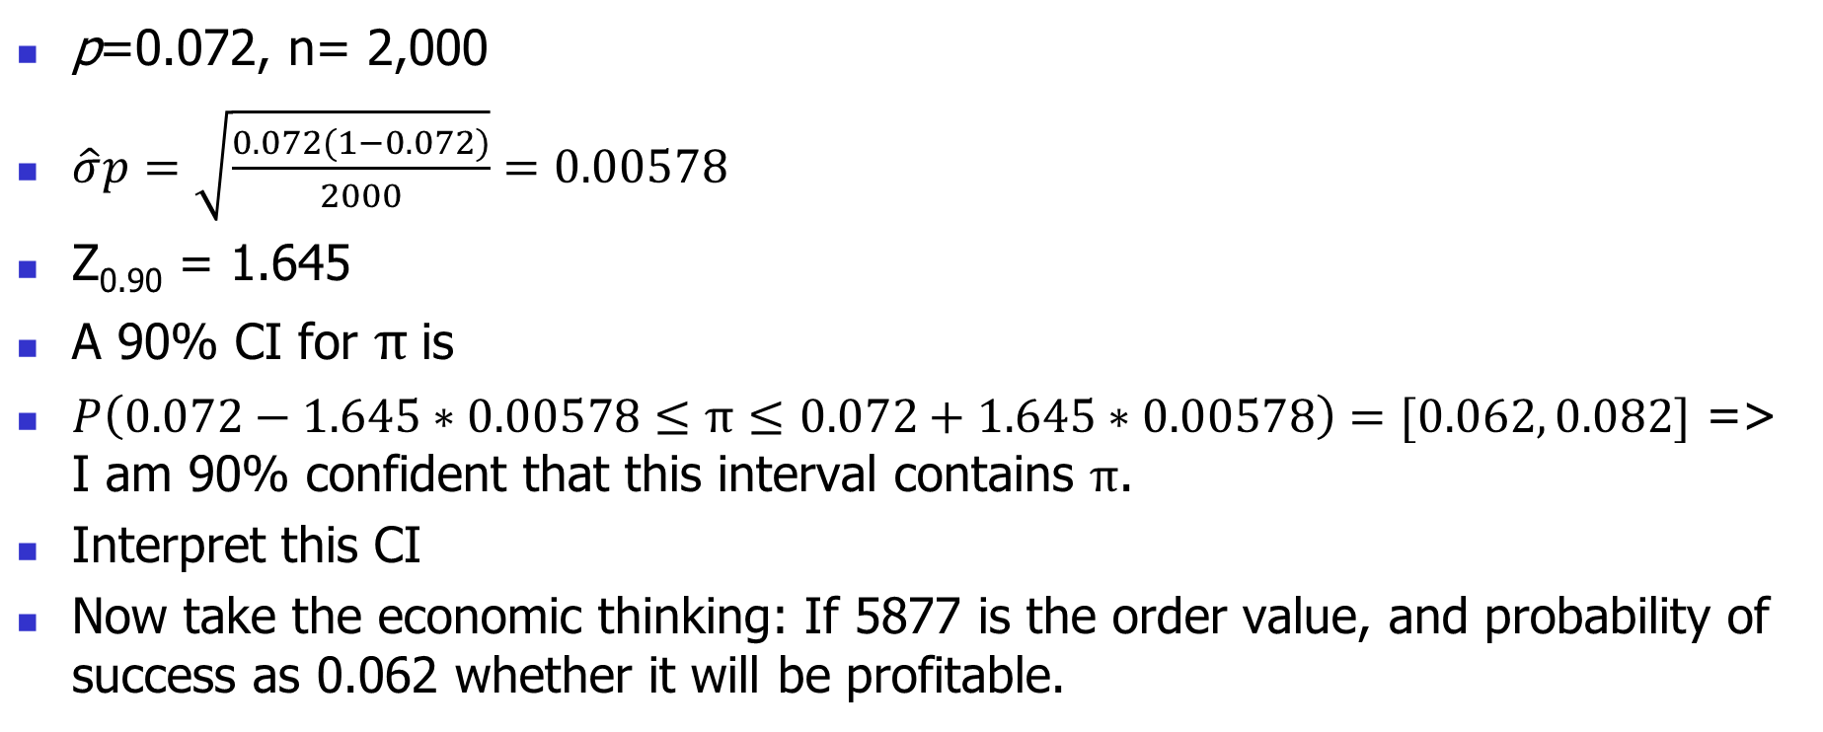
SariSagar revisited
p=0.072, n= 2,000
$\hat{σ}p=\sqrt{\frac{0.072(1−0.072)}{2000}}=0.00578$
Z_{0.90} = 1.645
A 90% CI for $π$is
$P\left(0.072−1.645∗0.00578≤π≤0.072+1.645∗0.00578\right)=[0.062, 0.082]$ => I am 90% confident that this interval contains $π$.
Interpret this CI
Now take the economic thinking: If 5877 is the order value, and probability of success as 0.062 whether it will be profitable.

Slide 30
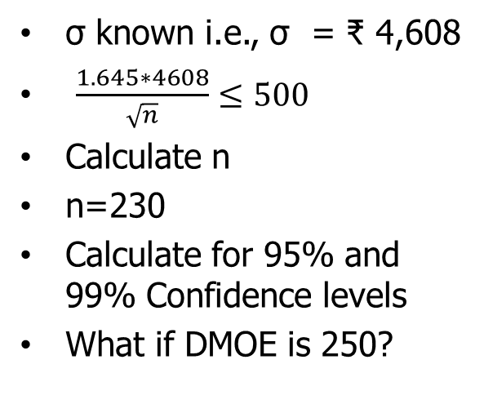
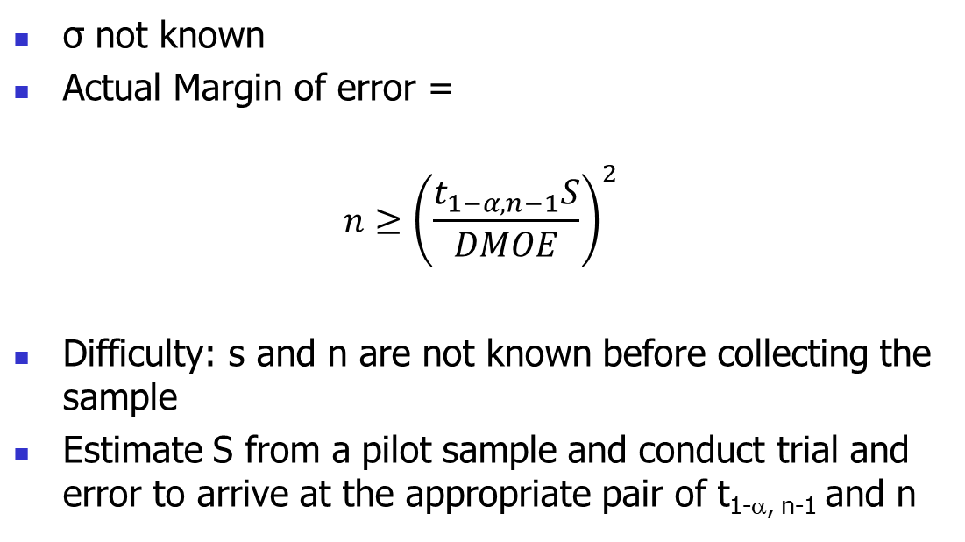
How Big a Sample to Get When Estimating Mean?
Depends on how accurate you want to be, i.e., desired margin of error (DMOE)
e.g. Average order size within ₹ 500 with confidence level = 90%
σ not known
Actual Margin of error =
$$n≥{\left(\frac{t_{1−α,n−1}S}{DMOE}\right)}^{2}$$
Difficulty: s and n are not known before collecting the sample
Estimate S from a pilot sample and conduct trial and error to arrive at the appropriate pair of t_{1-α, n-1} and n
σ known i.e., σ = ₹ 4,608
$\frac{1.645∗4608}{\sqrt{n}}≤500$
Calculate n
n=230
Calculate for 95% and 99% Confidence levels
What if DMOE is 250?
Notes:
OK, now we come to an important question of how big a sample should be. Thinking about it from a first principles basis – the main thing that the sample size impacts is the margin of error. So then, you want to target a certain margin and then back calculate the sample required for a given significance level. Here by margin of error, I mean absolute difference in the actual mean and the sample mean.

Slide 31
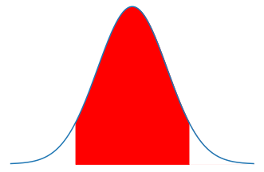





How Big a Sample to Get When Estimating Mean?
$$Z_{\frac{1−CI}{2}}$$
$$Z_{\frac{1+CI}{2}}$$
CI
precision
precision
$\overline{X}−s_{\overline{x}}∗$ $Z_{\frac{1−CI}{2}}$
μ = $\overline{X}$
$\overline{X}+s_{\overline{x}}∗$ $Z_{\frac{1+CI}{2}}$

Slide 32
How Big a Sample to Get When Estimating Proportion?
Depends on how accurate you want to be, i.e., desired margin of error (DMOE)
e.g. Proportion of acceptances within 3%
Actual Margin of error =
Difficulty: p is not known before collecting the sample
Utilize the fact that 0≤p≤1 and obtain a conservative estimate with p = 0.5 since it yields the largest value for p(1-p)
What is the sample size required to estimate the proportion of SariSagar offer acceptance within 3% of the population estimate at 95% confidence?
Notes:
OK, now we come to an important question of how big a sample should be. Thinking about it from a first principles basis – the main thing that the sample size impacts is the margin of error. So then, you want to target a certain margin and then back calculate the sample required for a given significance level. Here by margin of error, I mean absolute difference in the actual mean and the sample mean.

Slide 33
Examples
A nutritionist wants to know the average calorie intake for female customers to within ± 50 calories with 95% confidence. A pilot study gives an estimate of 430 calories for σ. Find n.
Start with z=1.96
Calculate
The actual margin of error for this sample size is approximately 50.13, which is greater than DMOE
You can fine tune further by increasing n until you get actual margin of error as exactly 50
This is roughly 287
What is the sample size required to estimate the proportion of responses at Sarisagar within 3% of the population estimate at 95% confidence?

Slide 34
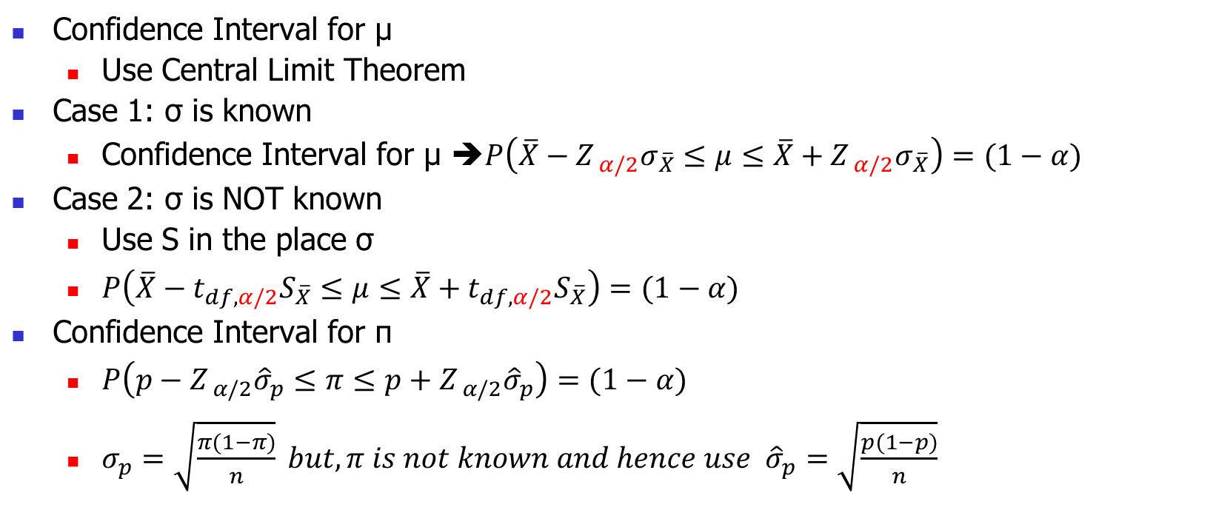
Review
Confidence Interval for μ
Use Central Limit Theorem
Case 1: σ is known
Confidence Interval for μ ➔$P\left(\overline{X}−Z_{ α/2}σ_{\overline{X}}≤μ≤\overline{X}+Z_{ α/2}σ_{\overline{X}}\right)=(1−α)$
Case 2: σ is NOT known
Use S in the place σ
$P\left(\overline{X}−t_{df, α/2}S_{\overline{X}}≤μ≤\overline{X}+t_{df, α/2}S_{\overline{X}}\right)=(1−α)$
Confidence Interval for π
$P\left(p−Z_{ α/2}{\hat{σ}}_{p}≤π≤p+Z_{ α/2}{\hat{σ}}_{p}\right)=(1−α)$
$σ_{p}=\sqrt{\frac{π(1−π)}{n}} but, π is not known and hence use {\hat{σ}}_{p}=\sqrt{\frac{p(1−p)}{n}}$

Slide 35
Summary of Session 2
How to provide an interval estimate (confidence interval) for a population parameter such as mean and proportion?
The sample statistic provides a point estimate
The interval estimate can be specified by adding and subtracting a margin of error to the point estimate
The size of the margin of error depends on the level of confidence, the variation in the data and the sample size
We can use sample standard deviation as an estimate of population standard deviation and use t-values instead of z-values to construct the intervals
The sample size depends on the margin of error, the standard error and the desired confidence level. For proportions, we can get a conservative sample size by using p = 0.5.
How to adjust the interval estimate if the population standard deviation is not known?
What should be the sample size to collect for a desired width of the interval estimate?

Slide 36
Software Notes
Confidence Intervals
Analyze>Distribution (creates a Histogram)
Next, Click the red triangle near the variable name > Confidence Interval > In pop up window specify the confidence level needed > Ok
Confidence Intervals for proportion can be calculated similarly by first appropriately defining the modelling type for the variable (as nominal)
Analyze > Distribution (Creates the Histogram for proportions/counts)
Next, Click the red triangle near the variable name > Confidence Interval > In pop up window specify the confidence level needed > Ok

Slide 37
Questions?

